Slide 1

Smart Park
Senior Design I
Developers:
Phong Vo, Tuan Nguyen, Trong Van, Paulina Castaneda, Kevin Le
Hardware:
Alex Chiem, Martin Kariuki, Damian Avery, Max Burrell

Slide 2

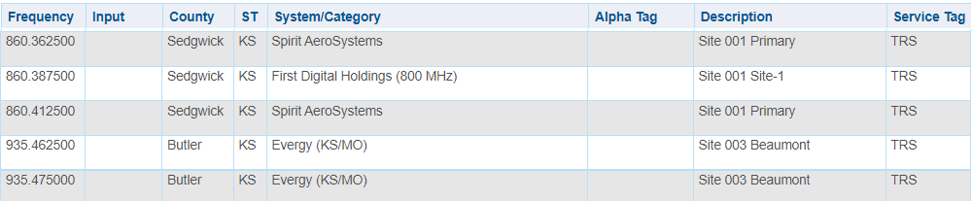
LoRa /LPWAN Compliance
DAMIAN
Low data, low power, long range
US915 = 902-928Mhz -“RP002-1.0.3 LoRaWAN® Regional Parameters” -Lora Alliance
V1.0.3 LoRa Compliant -“LoRaWAN™ 1.0.3 Specification” -Lora Alliance
Supports Class B devices “Beacon”
Diagnostics

Slide 3
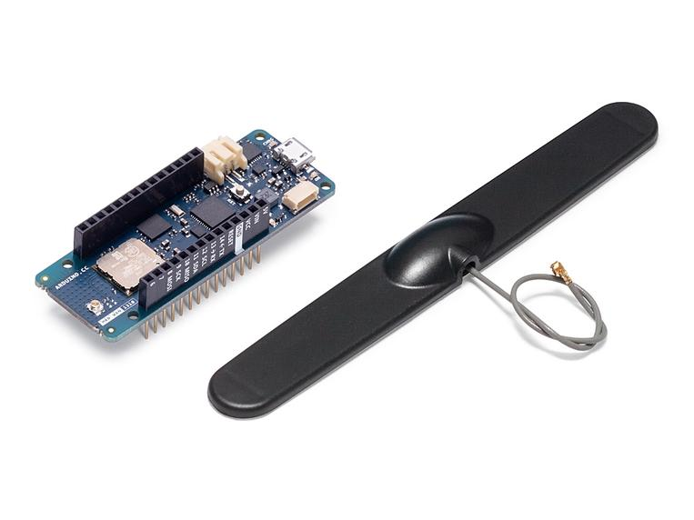
Sensors and Electrical Components
MARTIN
Arduino MKR WAN 1310
Versatile
Low power consumption
Onboard storage
Open-Source hardware

Slide 4
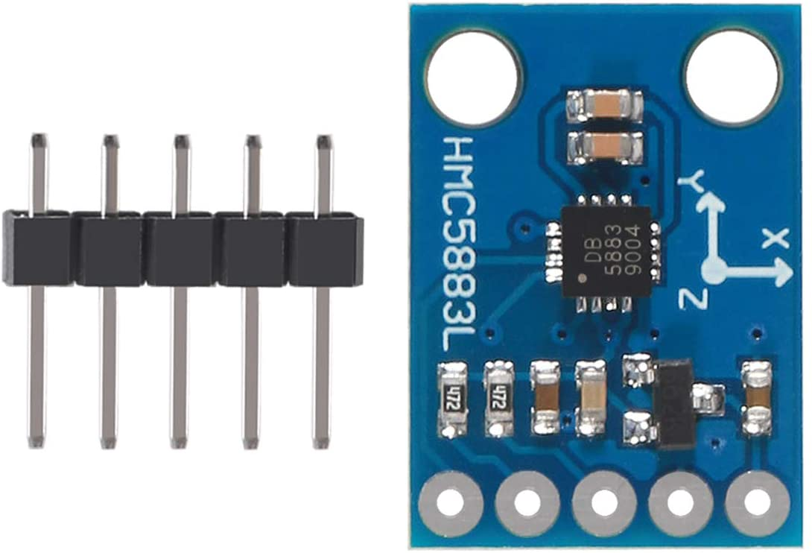
Sensors and Electrical Components
MARTIN
Magnetometer
Weather resistant
Longer life-cycle
Low maintenance
Long-term reliability
Less invasive

Slide 5
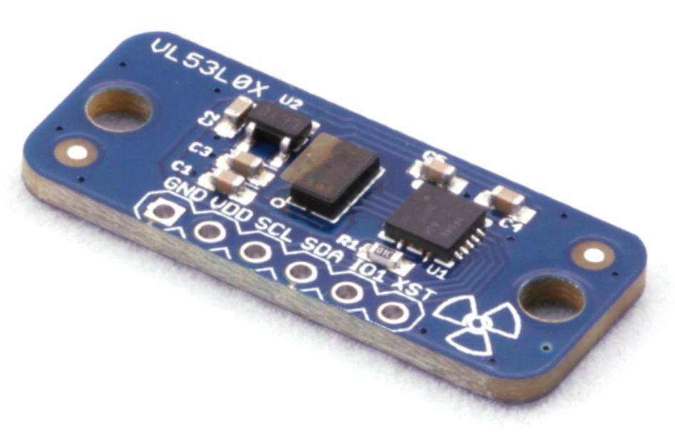
Sensors and Electrical Components
MARTIN
Time of flight sensor
Simplicity
Efficiency
Speed
accuracy

Slide 6
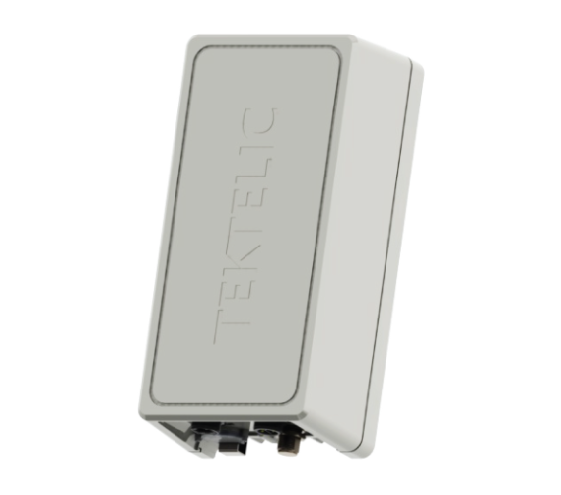

How they work
MARTIN
Magnetometer is wired to Arduino MKR WAN 1310, whileous wan Arduino 1310 transmits data wirelessly to Tektellic Kona Macro gateway.
Wired

Slide 7
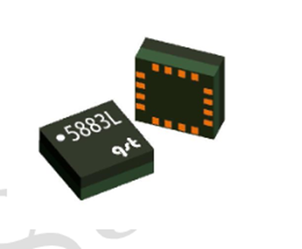
Package Specs
MAX
Operating Temps:
Arduino: -76F – 302F
Magnetometer: -40F – 185F
Time of Flight: -4F – 158F
Sensor Range:
Magnetometer: Around 2 meters (6.6 ft)
Time of Flight: 0.6 – 2 meters (2 – 6.6 ft)
Signal Speed:
Magnetometer:10 – 200 Hz (5 – 100 ms)
Time of Flight: 20 – 200 ms (Hi-speed to Precision)
Power Use:
At Sleep: 114uA (0.114mA)
Receiving: 36mA
(864mAh for 24 hours)
Sending (Normal/Boost): 80mA/161mA
(1910.4mAh/3854.4mAh for 24 hours)
Send/Receive (Normal/Boost): 83mA/164mA
(2774.4 mAh/4718.4 mAh for 24 hrs)

Slide 8
Energy Storage Solutions
ALEXANDER
Lithium Ion Battery
In Operation:
Charging: 32F - 113F
Discharging: –4F - 140F
In Storage:
For 1 Month: -4F - 113F
For 6 Months: 14F - 95F
Issue: Bad at low temperature
Lithium Thionyl Chloride Battery
Operating Temp: -76F - 185F
Issue: It is non rechargeable
Solar Panel
Based on a 2” x 1” panel in ideal conditions, around 30mA can be captured.

Slide 9
Hardware and Infrastructure Logic
PHONG
MKRWAN Arduino 1310
Built in Murata LoRa transceiver
Magnetometer/Time of Flight
Two points of failure
Initial Set-up
OTAA vs ABP
LoRaWAN v1.0.3
Class A vs Class B vs Class C
LoRaWAN Gateway // once data arrives on Gateway
MQTT vs. HTTP
Other integrations (InfluxDB)

Slide 10
Application Development
Front End

Slide 11
Environment & Visual Aspects/UX
TRONG
Environment
Swift
Xcode & SwiftUI
Visual aspects
Adobe photoshop for logo
SynFig studio for the animation screen
Virtual parking lot with swift
User experience
Cross-device compatible
Light/Dark theme
Colorblind friendly

Slide 12
Functionalities and Testing
TUAN
How it works
Map of user location
Pins on top of compatible parking lots
Taking data in JSON format
Notification service
Testing
Start with a soft opening
Focus on simplicity and intuitiveness

Slide 13
Apple Store Regulations
KEVIN
Apple Development Program
App specifications, Upload to Apple Connect
Safety
Intellectual Property Infringement, developer information, proper user info. security
Performance
App completeness, accurate metadata, hardware compatibility
Business
Design
Work on its own
Legal
Comply with laws, privacy policy, consent for location data, location data must only be used for app functionalities
Notes:
Apple development program 99/yr
Set app specs, upload for apple to review on apple connect
Metadata - transparency to the user what the app will collect and accurate pictures as to what they will be using

Slide 14
Back-End

Slide 15
Logistics
PAULINA
Admin Account Access vs Regular user account access
Admin can add/remove parking spaces and parking lots
Admin account will be accessed through the same application or through a separate mobile app or web application
How Smart Park data will be stored
App will display Wichita State Parking lots with pins per each lot
Pins will be created and stored in database (google firebase)
Pins will consist of XY coordinates pertaining to specific a parking lot at WSU
Each time the app is opened, pins stored in the database are pulled in and loaded on to the WSU parking map
After parking lot is loaded in, the user can see available and unavailable parking spaces
After every N seconds, an API call is made to the database and a boolean value (true/false) is returned

Slide 16
Google Firebase
PAULINA
Allows for features such as notifications, invites, dynamic links, etc.
Offers real time updates for applications
Can create API’s inside of Firebase
Has an SDK to be implemented in Python REST API
Language of choice

Slide 17
Works Cited
For Lithium Thionyl Chloride Batteries:
https://www.jauch.com/blog/en/advantages-and-special-features-of-lithium-thionyl-chloride-batteries/
Lithium Ion Battery
https://www.adafruit.com/product/5035
For Solar Panel:
https://www.amazon.com/AOSHIKE-Electric-Materials-photovoltaic-53x30MM/dp/B07BMMHMSJ/ref=pd_sbs_1/146-3026540-9219838?pd_rd_w=N7lxg&pf_rd_p=690958f6-2825-419e-9c16-73ffd4055b65&pf_rd_r=6SD48SCTD37QPZ5XHADQ&pd_rd_r=8215393c-f645-4671-a0dc-fbfdce2cb3b8&pd_rd_wg=kwfhY&pd_rd_i=B07BMMHMSJ&psc=1
For MKR WAN 1310 On Board Components
https://store-usa.arduino.cc/products/arduino-mkr-wan-1310
Magnetometer
https://usermanual.wiki/Document/QMC5883LDatasheet10.1354705718/html
Time of Flight Sensor
https://learn.adafruit.com/adafruit-vl53l0x-micro-lidar-distance-sensor-breakout
Apple Regulations
https://developer.apple.com/app-store/review/guidelines/

Slide 18
Questions
?

